Slide 1


AFL 2023 Player Performance
Michael Le

Slide 2
Purpose
The goal for this project is to evaluate player performance evaluation, during the 2023 season. There are 808 players in total currently playing, the list of data include such as Player name, Fantasy Points, Rating Points, Goals, Kicks, Marks, Tackles etc. By analysing performance data, analysts can identify strengths and weaknesses. This can enable coaches to pick up new strategies in future matches. To make informed decisions on player selection, match strategies and training focus areas based on data insights. Allowing further prevention when it comes to injuries and manage recovery plans accordingly. Making easier process to identify potential talent when drafting new players or making trades.

Slide 3
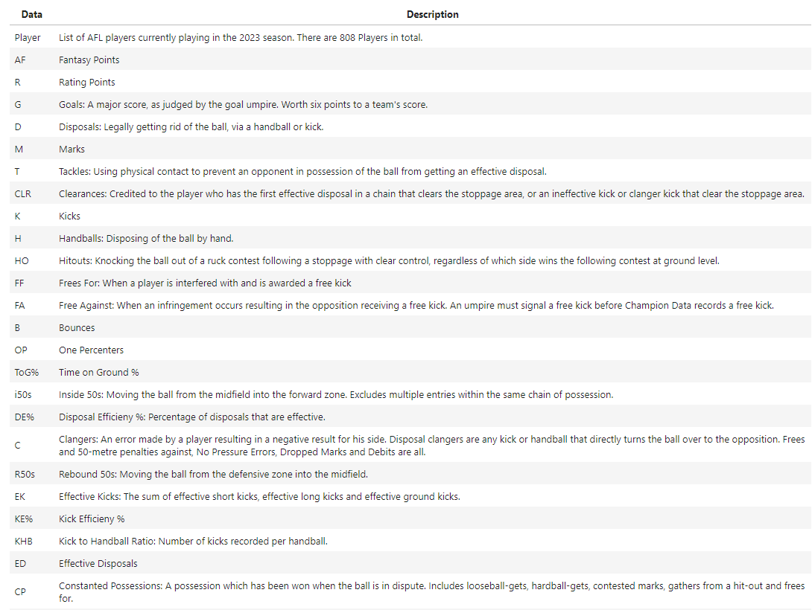
Data Collection
We will often refer to the data information for future analysis.

Slide 4
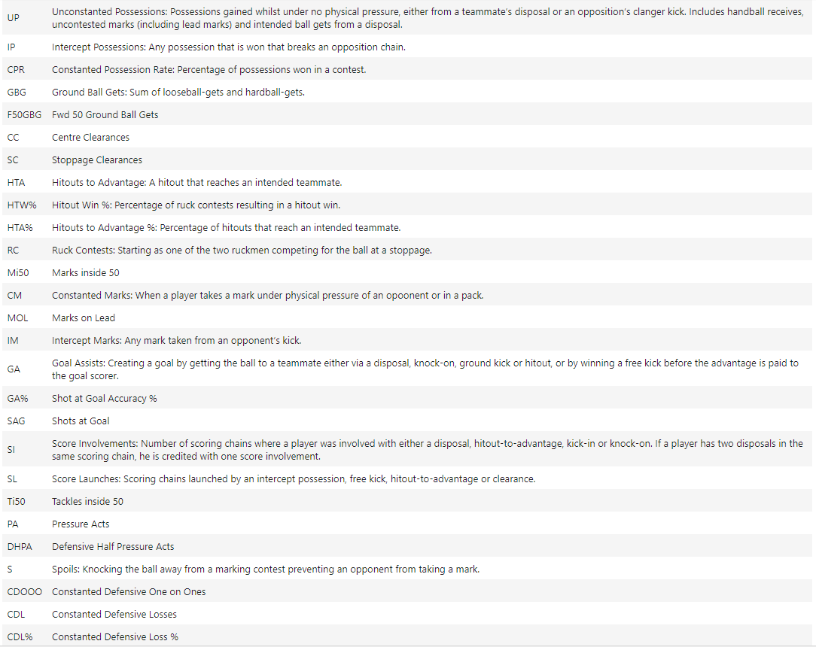

Slide 5
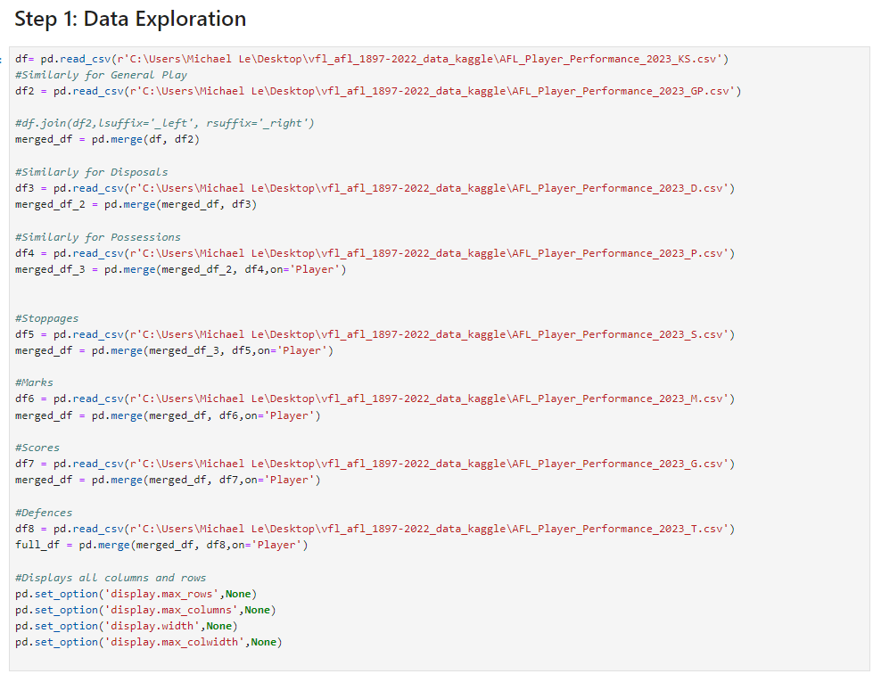
Procedure
The procedure to start the analysis, I have use technologies such as Python one of the programming languages used to performing analysis. This enables me to use library packages, such as pandas, numpy, matplotlib.pyplot and seaborn to collect the data to perform data analysis on Player Performance. To achieve this, I have merged all of the eight datasets to include all the columns and data entries for each of the players information without any loss.

Slide 6
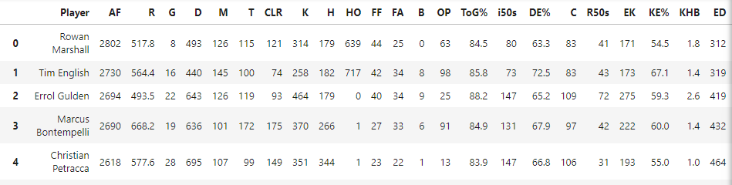
Procedure Part 2
In the next step, we need to clean the data for the player performance dataset. Removing row entries that contain empty or missing data entry and remove duplicate rows and columns. We wanted to re-order the Player column to
easily keep track on the players. After cleaning the data, we check the first 5 entries in our desired final data-frame with 808 rows and 52 columns. To ensure we can provide further exploration, apply feature engineering and visualisations.

Slide 7
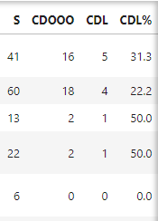
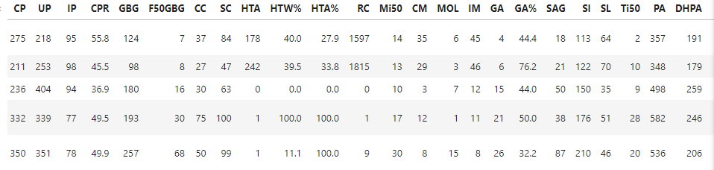

Slide 8
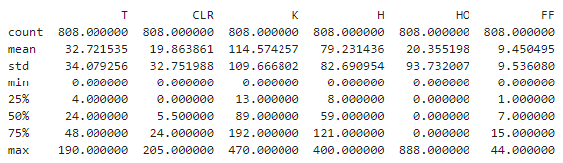
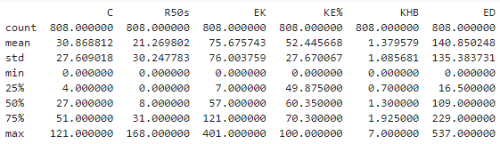
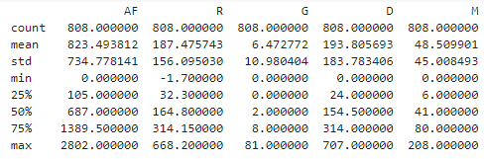
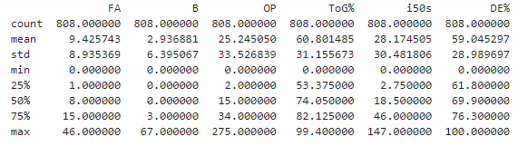
Data Exploration and Analysis
Summary Statistics

Slide 9
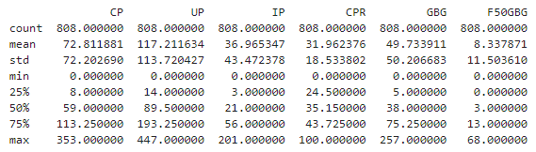
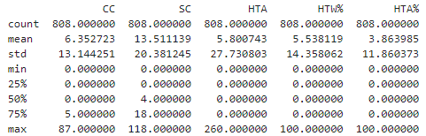
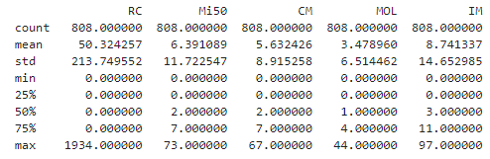
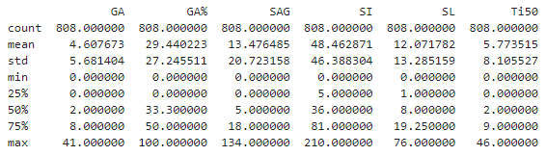
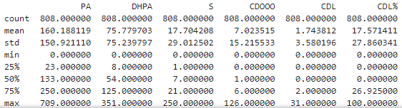

Slide 10
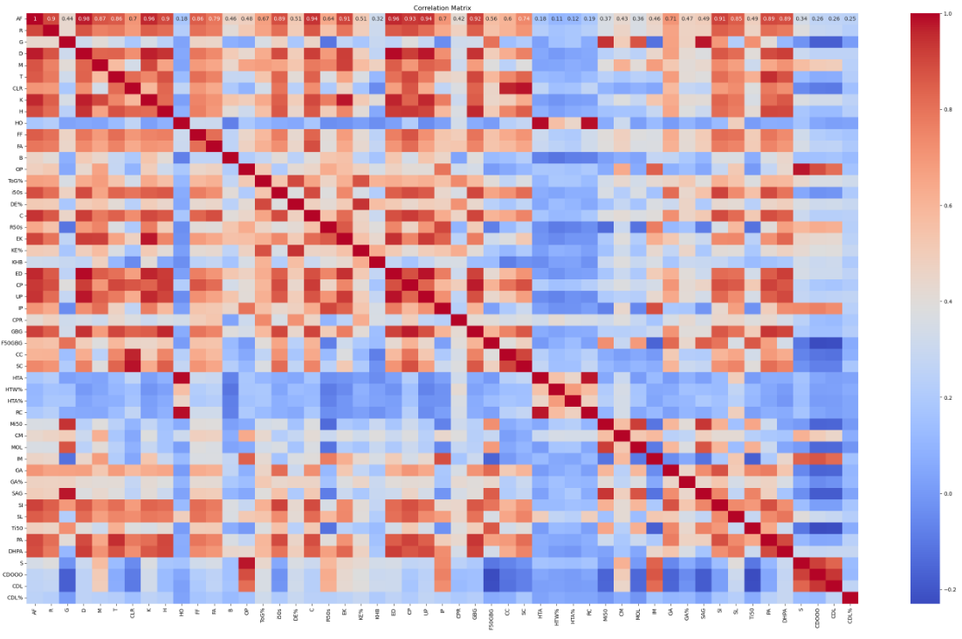
Correlation Matrix

Slide 11
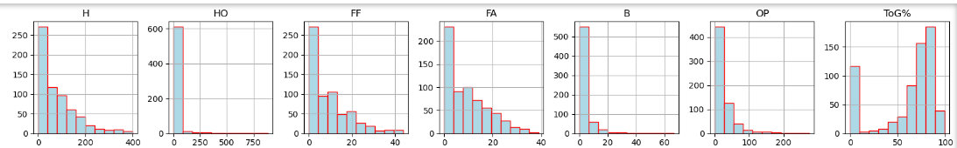
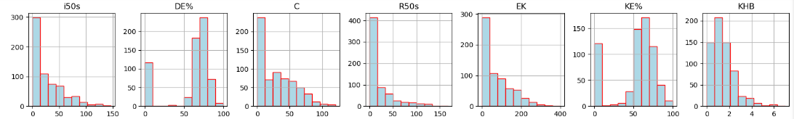
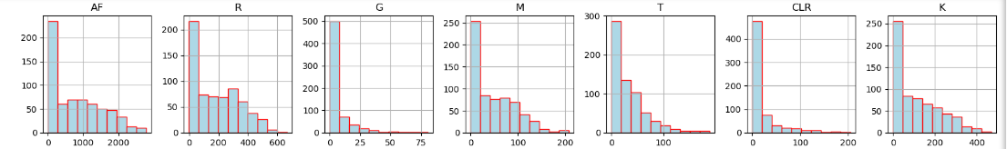
Histogram of the individual features
It appears for all the distributions for each of the individual features are positively skewed. Meaning that the data the mean and median values will be greater than the mode. Along the x-axis represent the bins (values) of the specific column, where the y-axis represent the total number of counts the data points falls in between.

Slide 12
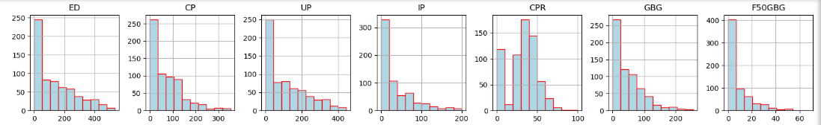
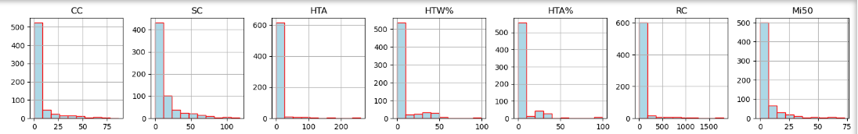
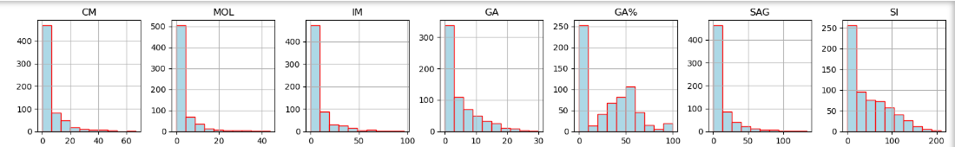

Slide 13
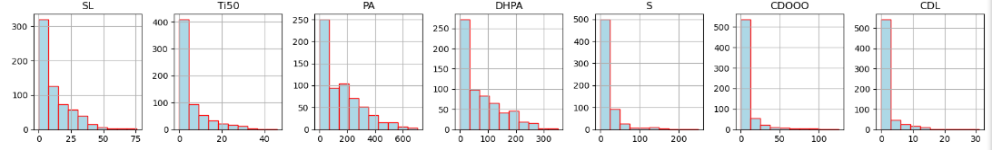
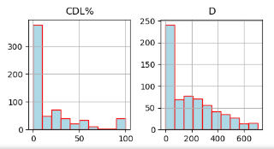

Slide 14
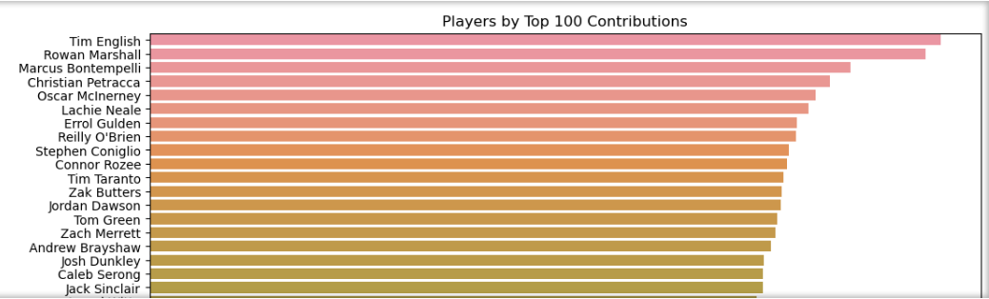
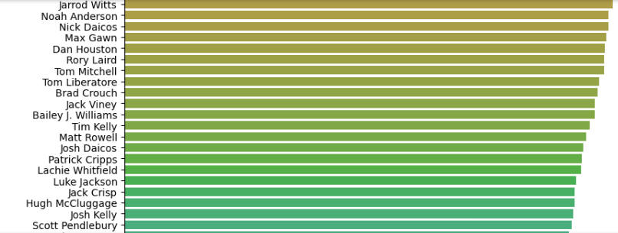
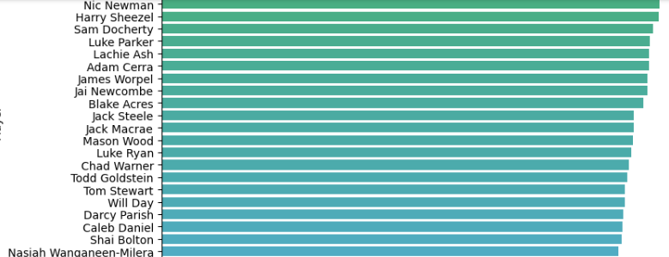
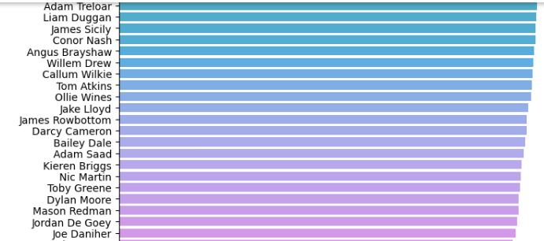
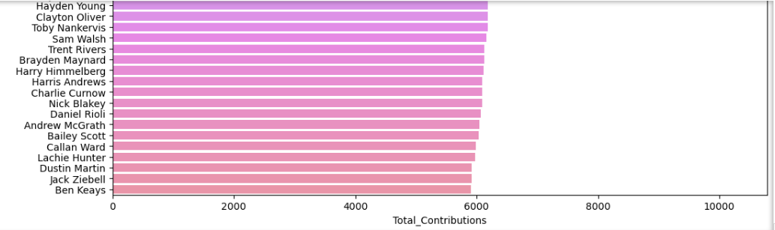
Top 100 Player Contributions

Slide 15
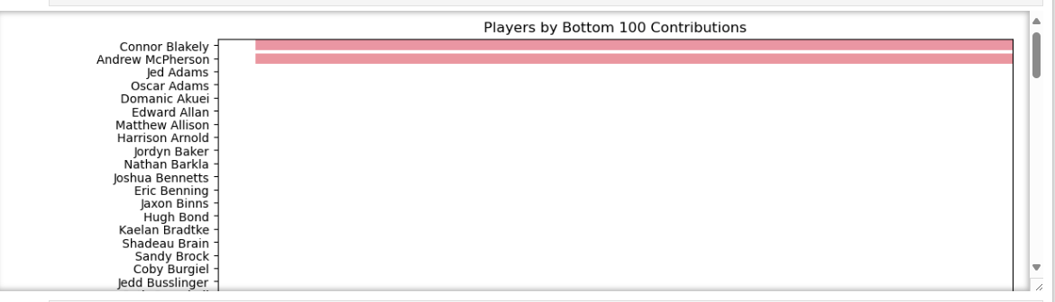
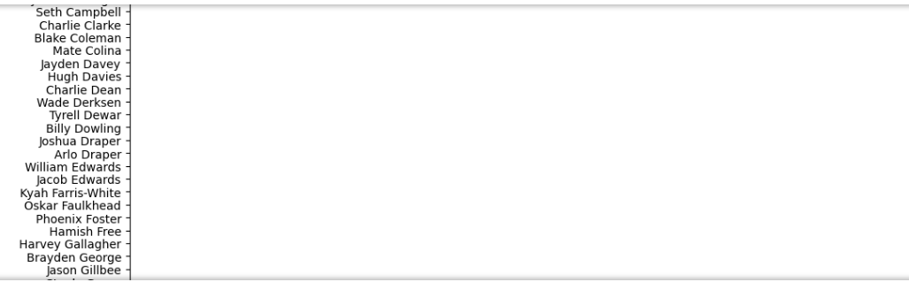
Bottom 100 Player Contributions

Slide 16
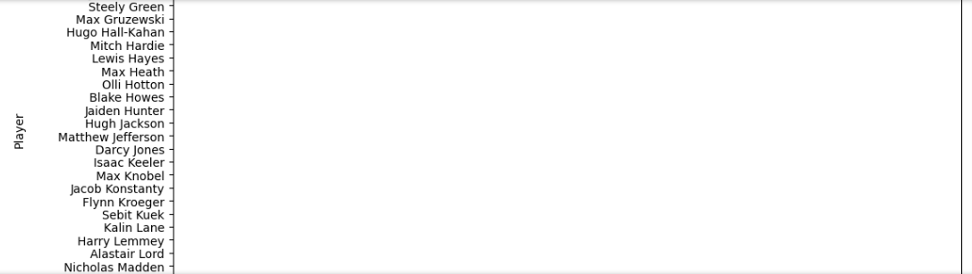
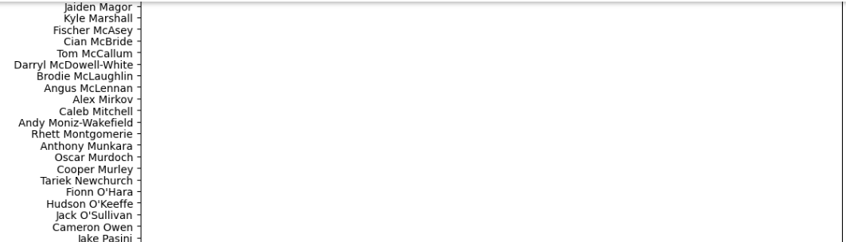

Slide 17
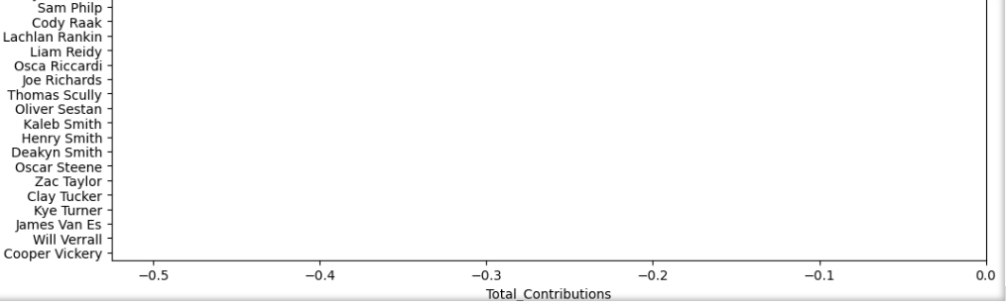

Slide 18
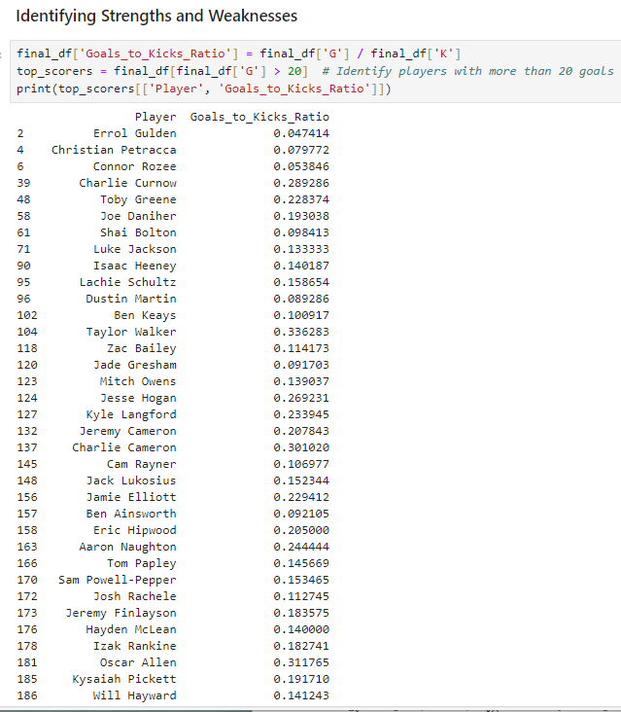
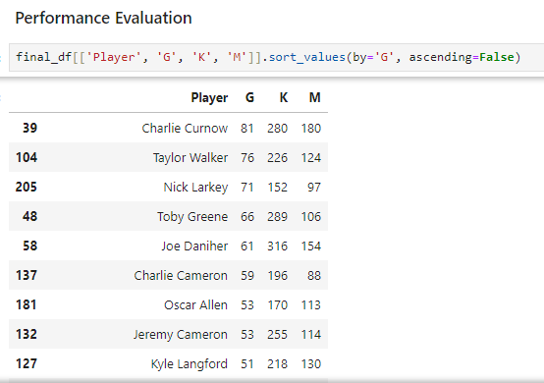
Further Data Analysis
Here were comparing key statistics
across players to determine who is performing well.
Here we analyze specific metrics to highlight areas of strength and improvement.

Slide 19
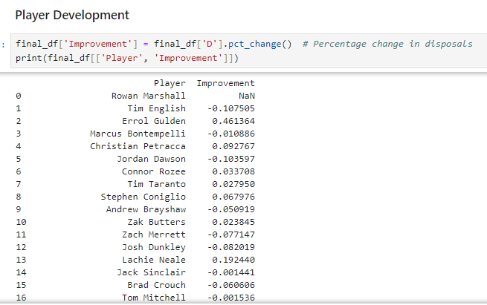
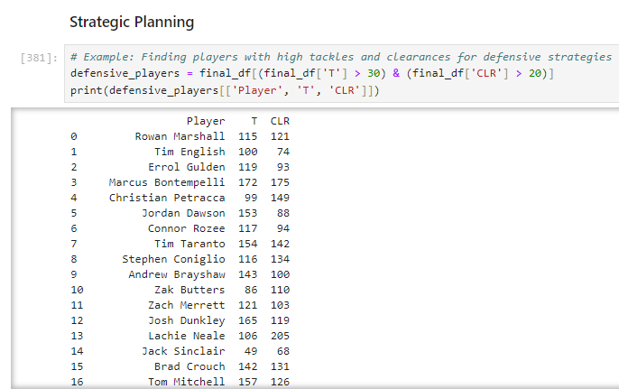
Track player progress and set development goals
Use data to make strategic decisions for upcoming matches.

Slide 20
Conclusion
The main goal of AFL player performance data analysis is to provide actionable insights for various stakeholders, including coaches, players, analysts, fans, and recruiters. These insights drive performance improvement, strategic planning, and fan engagement, ultimately contributing to the success and enjoyment of Australian Rules Football. Some suggestions to improve further analysis such as adding allocation for each of the players teams during the data collection phase. Other suggestions to improve this analysis is to consider Injury Prevention and Scouting and Recruitment. This achieves reducing the number of injuries occurring and improve potential recruits based on performance and historical data. Thus, reducing the number of mistakes and human errors to provide better insights to make decision making more effective.

Slide 21
Further Information
I have applied using data analysis on the AFL 2023 Player Performance datasets based on the link,
https://www.afl.com.au/stats/leaders?category=Key+Stats&seasonId=62&roundId=-1&roundNumber=0&sortColumn=dreamTeamPoints&sortDirection=descending&positions=All&teams=All&benchmarking=false&dataType=totals&playerOneId=null&playerTwoId=null
I have uploaded the datasets uploaded to Kaggle
AFL 2023 Player Performance (kaggle.com)

